Slide 1

Saudi Marathon 2023
Presented by:
Ahood Alsuhaibani
Lama Almegbil

Slide 2

AGENDA
Information about our dataset
Exploration of th dataset
Questions
Cleaning the dataset
Exploration data analysis
Conclusion

Slide 3
DATASET INFORMATION
Columns
Rows
It has 7 columns which are (rank,name,gender,nationality,gun time,chip time)
It has 12009 rows

Slide 4

QUESTIONS
What are the top 10 nationalities participating in Saudi marathons?
What are the 10 least nationalities participating in Saudi marathons?
What gender has the most participation in Saudi marathons?
What is the distribution of the ranking of females and males?
What is the number of participants according
to each category of the Saudi Marathons?
There is a relationship between rank and gun time?

Slide 5
Rank | Name | Gender | Category | Nationality | Gun Time | Chip Time
1 | 42eb63b2-5dba-4030-bf6d-2b1f83ac611b | Female | 4km | GBR | 19:02 | 18:41
2 | ab274d04-e39c-48d8-8dbd-4ecbce5cc95d | Female | 4km | KSA | 19:50 | 19:42
3 | 9b249d53-c90b-4b48-b23b-ec5f141ef44c | Female | 4km | FRA | 21:15 | 21:15
4 | 28e13d85-38d4-483c-b9cc-93b9bd9bde14 | Female | 4km | JOR | 21:32 | 21:25
5 | 0a1c87a5-344e-4d27-9182-32f654230ebb | Female | 4km | KSA | 21:55 | 21:40
EXPLORATION OF THE DATASET

Slide 6
Cleaning datadet
CLEANING DATASET
Drop some rows
Fill in some null values

Slide 7
EXPLORATION DATA ANALYSIS

Slide 8
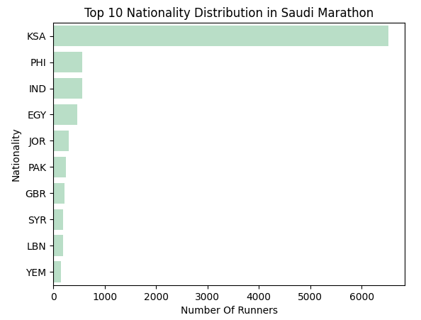

Slide 9
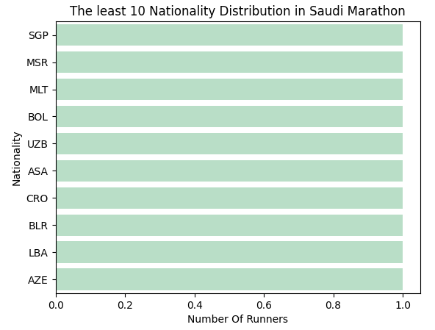

Slide 10
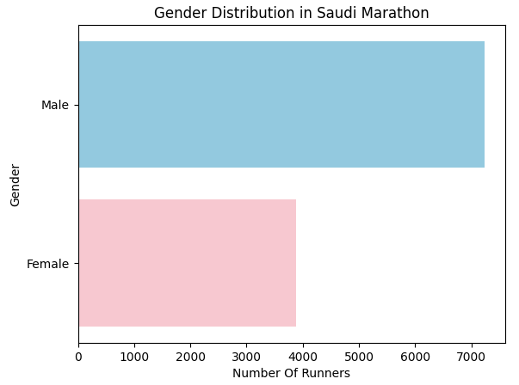

Slide 11
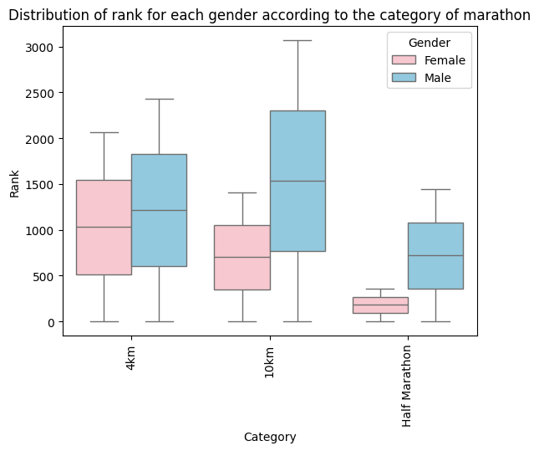
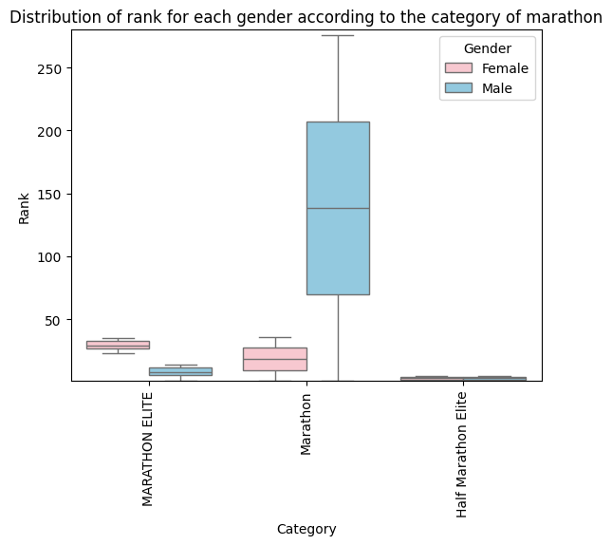

Slide 12
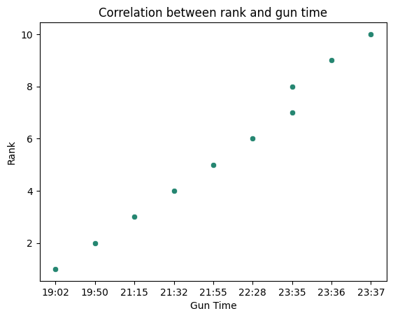

Slide 13

CONCLUSION
01
05
03
The most participating nationality in Saudi marathons is Saudi Arabia
The most-participating category of marathons was the 4 km category
Females are more likely to obtain first ranks than males
02
04
The most common gender group participating in Saudi marathons is male
There is an positive relationship between rank and gun time

Slide 14
THANK YOU FOR LISTENING

